Slide 1
Machine Learning
Final project
第一原理AI化-最佳SAA催化劑吸附能預測
Teammates: | 高睿成 陳冠儒 蔡沂華
Teachers: | 陳南佑 老師 楊安正 老師

Slide 2
Outline
Introduction
Training set
Feature engineering
Model
Results & discussion
Conclusion
Job arrangement

Slide 3
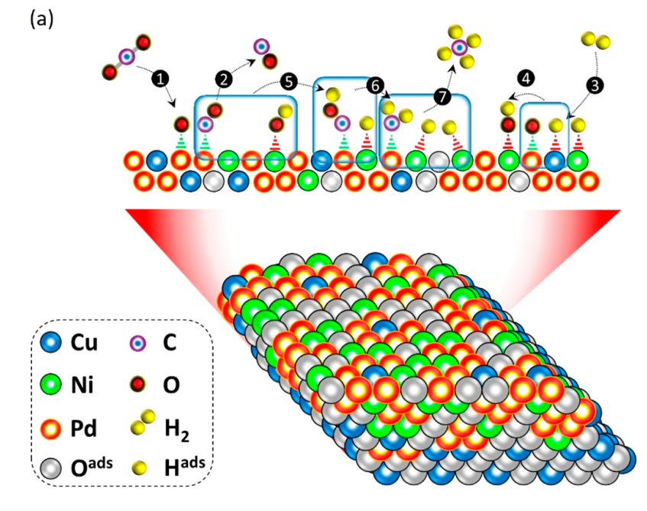
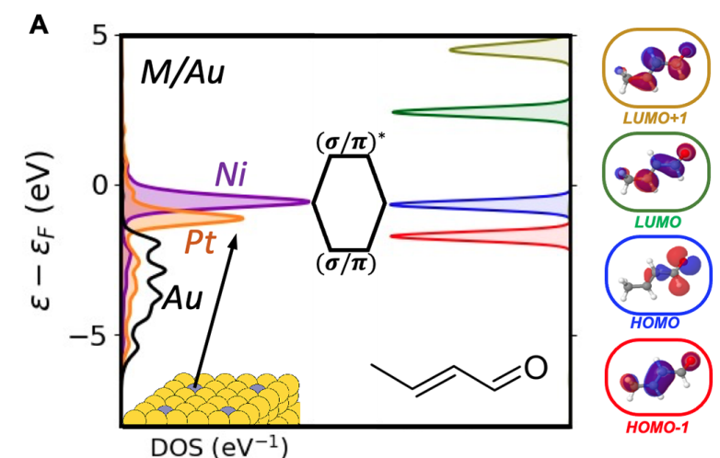
Introduction
Surface catalysis reaction highly depends on the adsorption energy.
The density of states (DOS) of the catalysts and adsorbates contribute the adsorption energy (E_{ads}).
Using machine learning to predict the adsorption energy of the reactants and intermediates through DOS plots.
CO₂RR
E_{ads}
ACS Appl. Energy Mater. 2021, 4, 14043−14058
J. Am. Chem. Soc. 2021, 143, 11897−11902
3

Slide 4
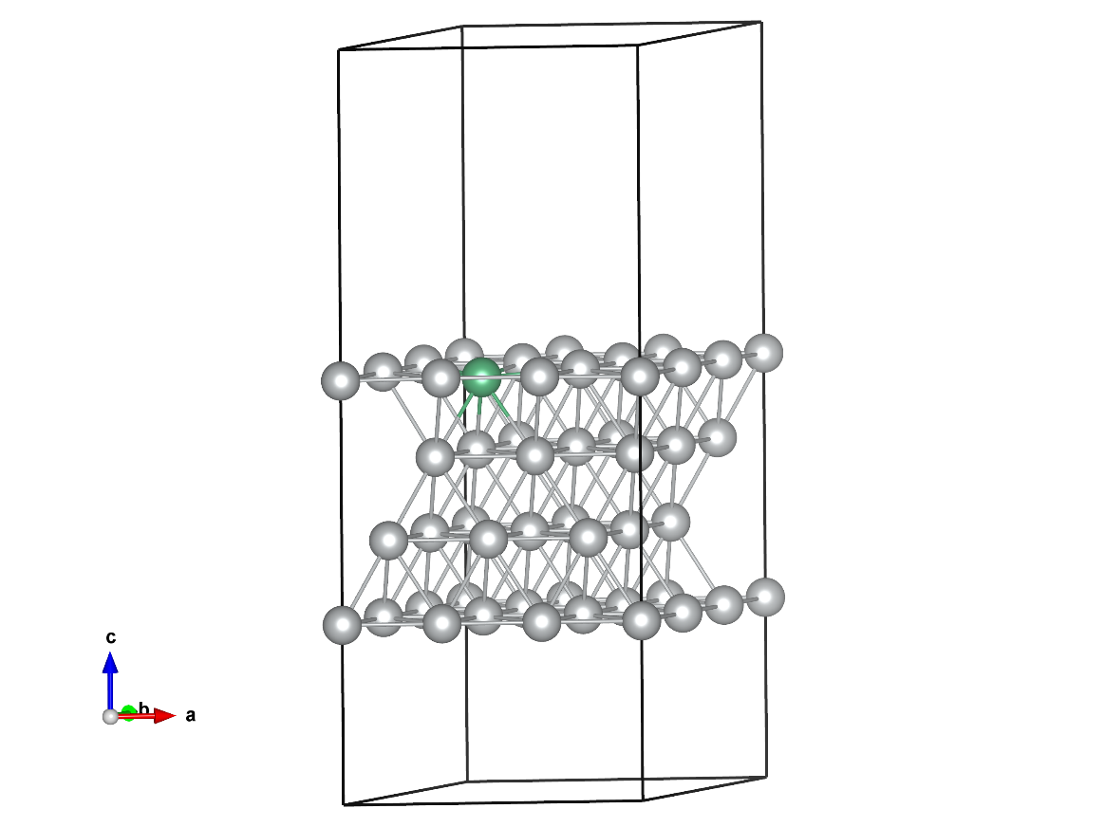
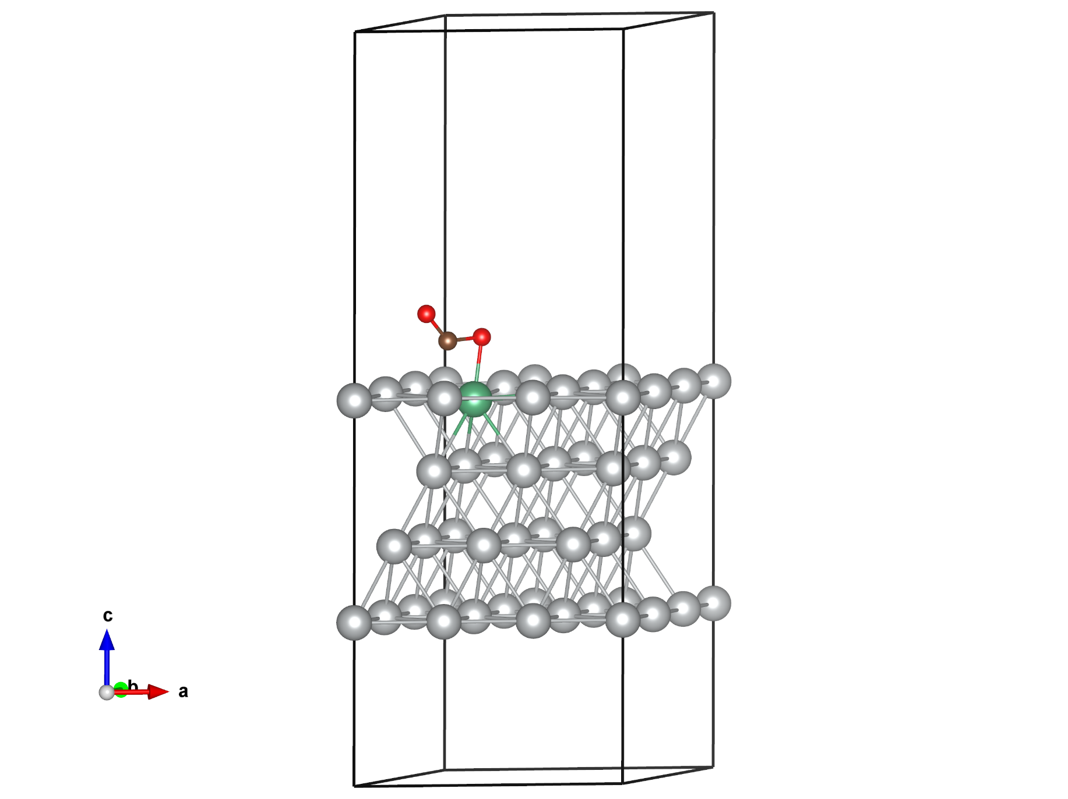
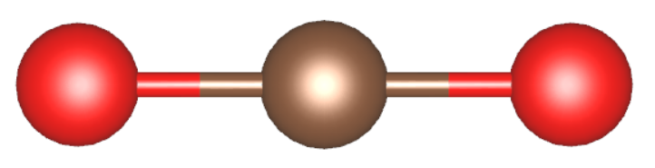
Introduction
Single atom alloy (SAA)
Bimetallic systems (dilute solution)
Weak mixing between constituent metal wave functions
Sharp and narrow d-band
Ag₃₅Nb₁
Strong E_{ads}
The interaction between d-band and adsorbate level
Gas adsorption
CO₂ adsorption on Ag₃₅Nb₁
4

Slide 5
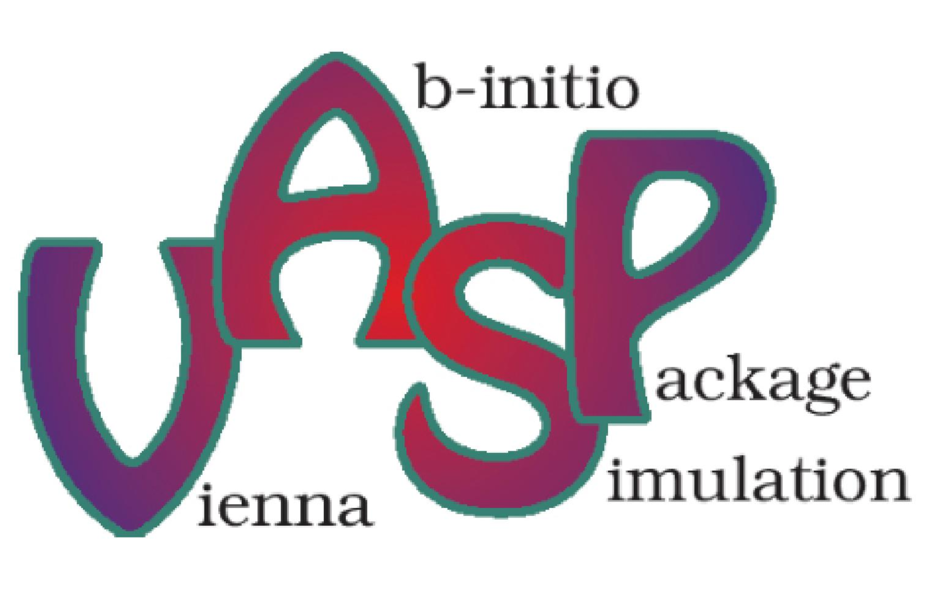
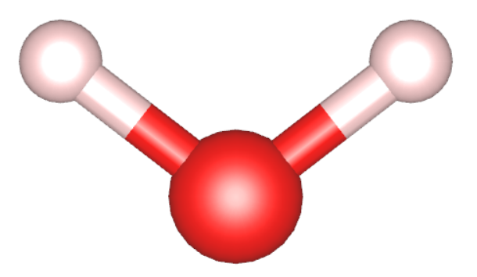
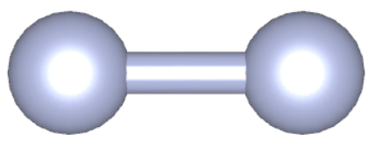
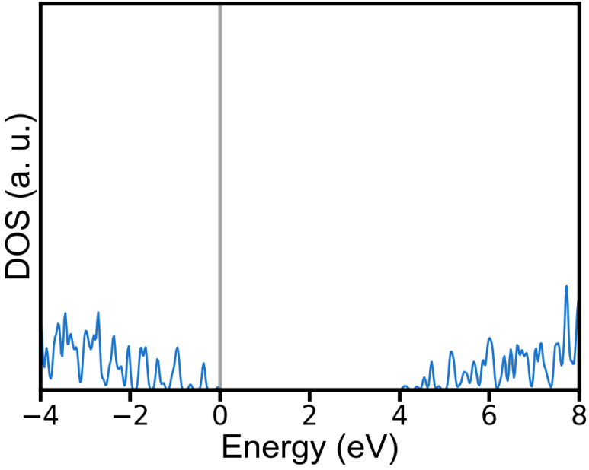
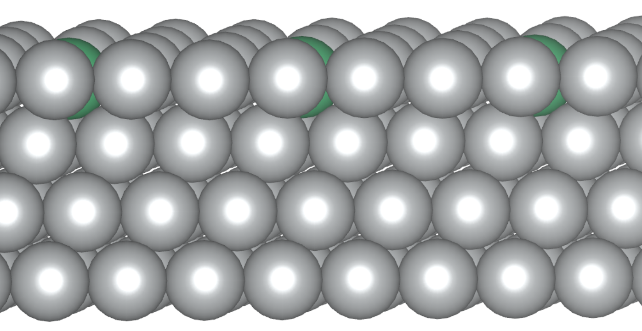
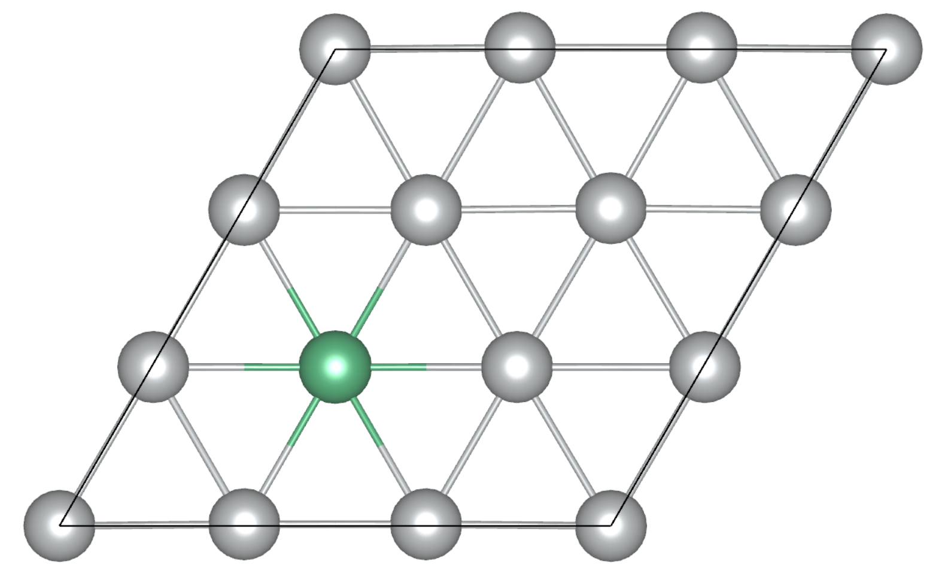
Training set
Density functional theory (DFT) calculation
4 atomic layers fcc (111) surface model
3 host elements + 20 guest elements + 16 adsorbates
960 combinations
TDOS + PDOS for the top 9 atoms on the surface and adsorbates with s, p, d channels
41 features
Input data (DOS)
Output data (E_{ads})

Slide 6
Data Generation
Host elements: Au, Ag, Cu
Guest elements:
Ti | V | Cr | Mn | Fe
Co | Ni | Zr | Nb | Mo
Ru | Rh | Pd | Hf | Ta
W | Re | Os | Ir | Pt
Adsorbates:
H | H₂ | OH | H₂O | O
O₂ | OOH | C | CO₂ | CO
CH₃ | COH | CHO | N | N₂
NH₃
J. Am. Chem. Soc. 2021, 143, 11897−11902
J. Mater. Chem. A, 2019, 7, 3531–3543
Chem. Sci., 2019, 10, 9165–9181
Energy Sci. Eng., 2021, 9, 1012–1032
ACS Catal., 2020, 10, 1754−1768
J. Phys. Energy, 2021, 3, 026001
Totally 960 combinations

Slide 7
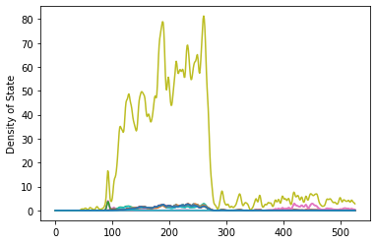
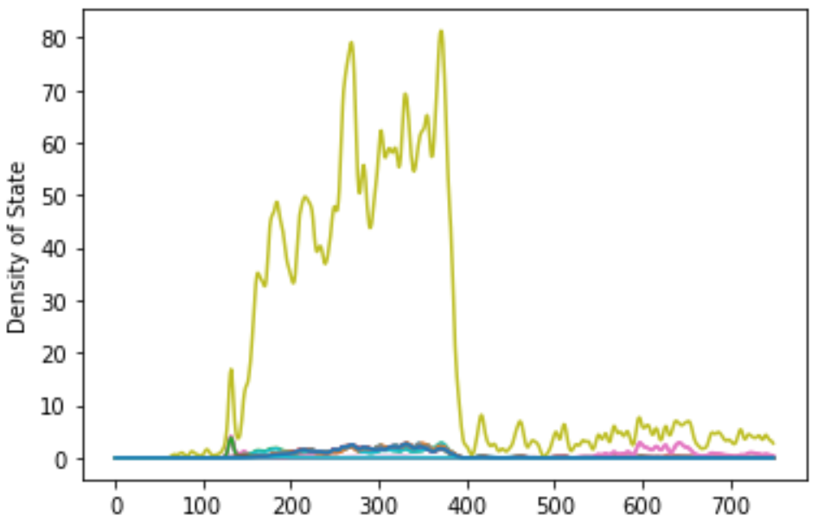
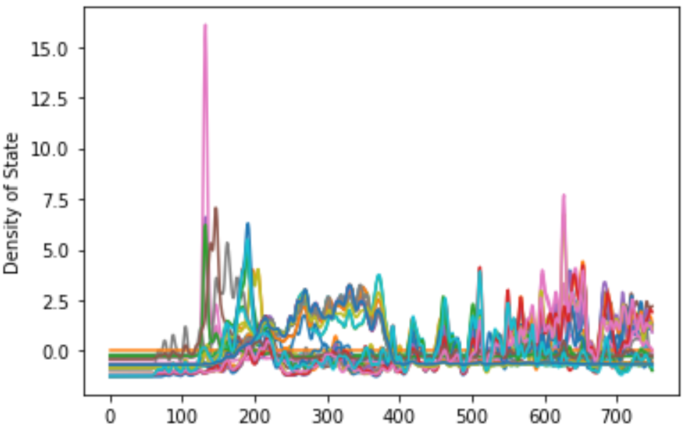
Feature engineering
Original
Interpolation
Standardization

Slide 8
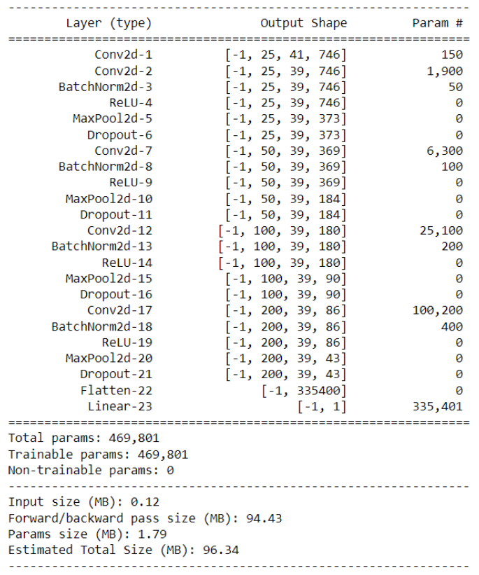
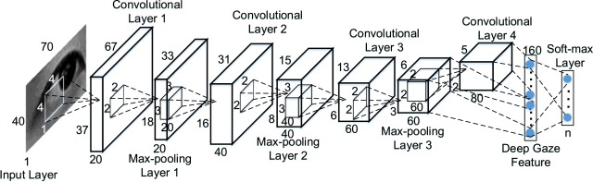
Model-DeepConvNet
Notes:
DeepConvNet 是一種通用架構,不限於特定的特徵類型

Slide 9
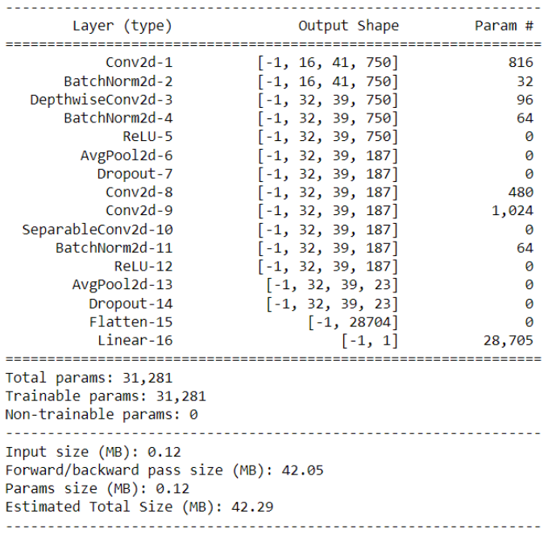
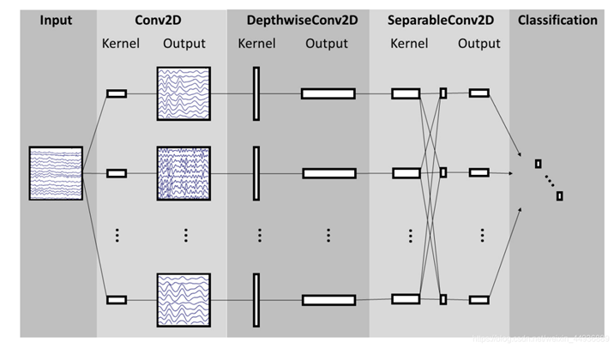
Model-EEGNet
Notes:
使用 Depthwise 和 Separable Convolutions 來構建,讓可訓練參數
大大的減少,故只要小的 dataset 就可以訓練起來。

Slide 10
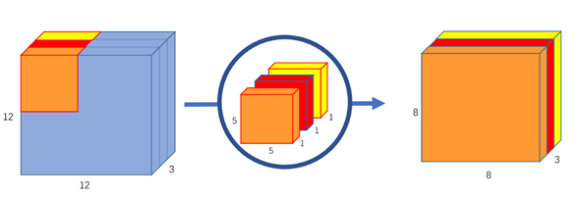
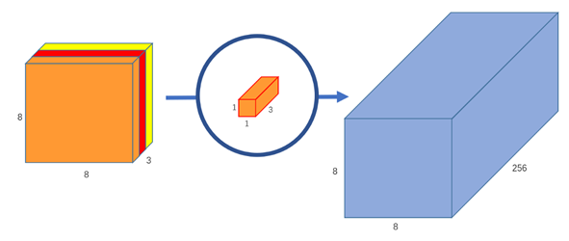
Model-EEGNet
DepthwiseConv2D
PointwiseConv2D
Notes:
使用深度卷積(depthwise convolution),單獨連接到每個 feature map,以學習特定於頻率的空間過濾器(frequency-specific spatial filters),
將 input 的各個 channel 單獨學習,一個 channel 會對應到一
個(D=1)或多個(D>1)kernel 進行 convolution。
使用 1x1 kernel 增加 image 的 depth,即增加 channel 的數量,讓我們學習時可以大幅減少參數的數量。

Slide 11
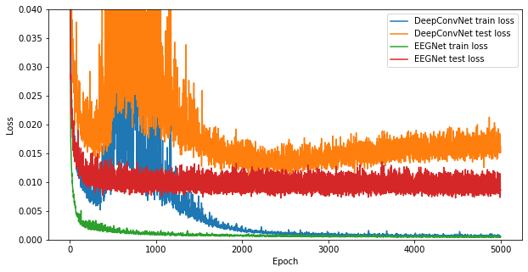
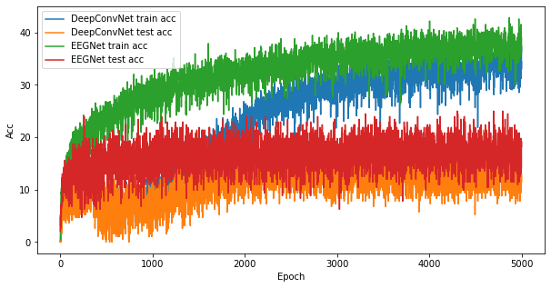
Results & discussion
The loss and accuracy
The overfitting occurs by using DeepConvNet model.
EEGNet model owns the better loss and accuracy.
Loss
Accuracy (%)
Epoch
Epoch
correct = |predict - ground_true| < |ground_true|*0.1
accuracy = correct/total_data

Slide 12
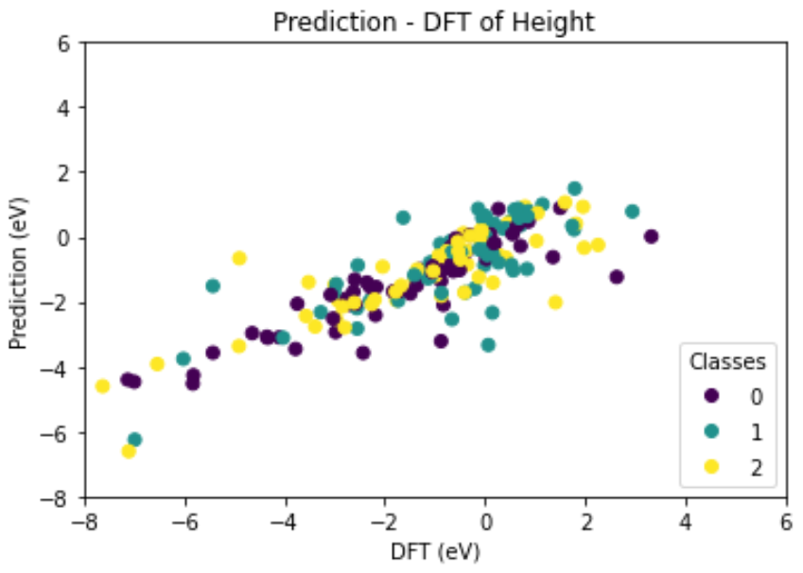
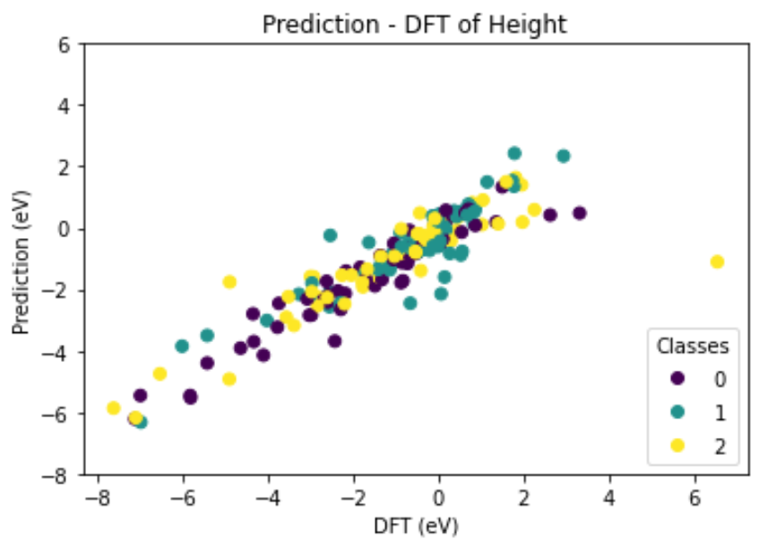
Results & discussion
Adsorption energy prediction
DeepConvNet
EEGNet
Prediction (eV)
Prediction (eV)
Ag
Au
Cu
Ag
Au
Cu
DFT (eV)
DFT (eV)
Loss: 0.008073789
Accuracy: 0.15625
Correlation: 0.821645
Loss: 0.004724495
Accuracy: 0.16146
Correlation : 0.900632
Notes:
EEGNet 預測的結果比較準確
Au-based SAA的吸附能偏弱➔較適合氣體脫附(Step2 reaction)
Ag-based SAA的吸附能偏強➔較適合氣體吸附(Step1 reaction)
Host element影響不大

Slide 13
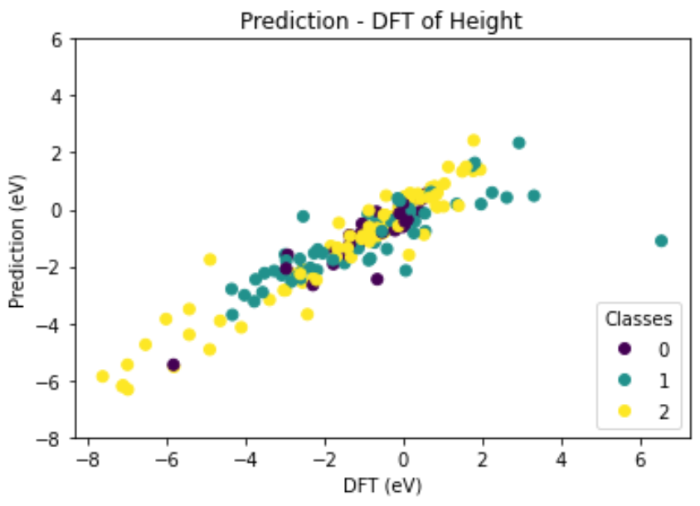
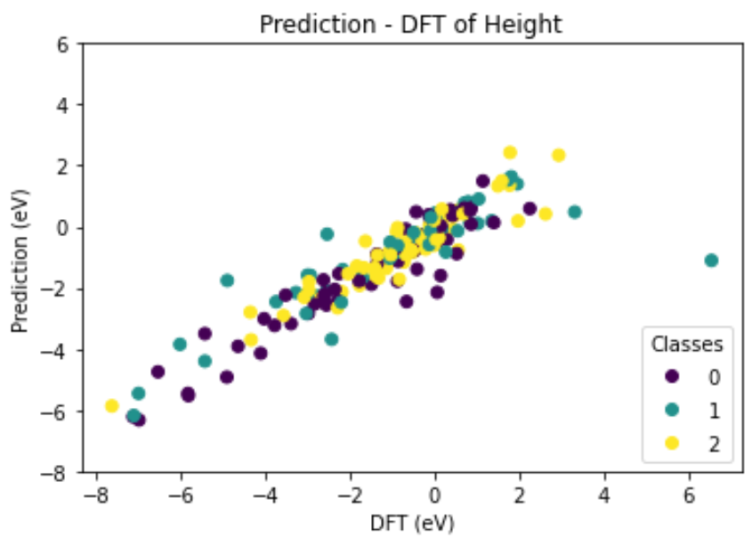
Results & discussion
Further analysis
EEGNet
Prediction (eV)
Prediction (eV)
H₂, O₂, N₂, CO₂
H, O, N, CO
Others
Period 4 elements
Period 5 elements
Period 6 elements
DFT (eV)
DFT (eV)
The single atom adsorption displays the stronger adsorption ability.
The weak E_{ads} from period 6 elements SAAs may be due to the screening effect caused from the 5f orbitals.

Slide 14
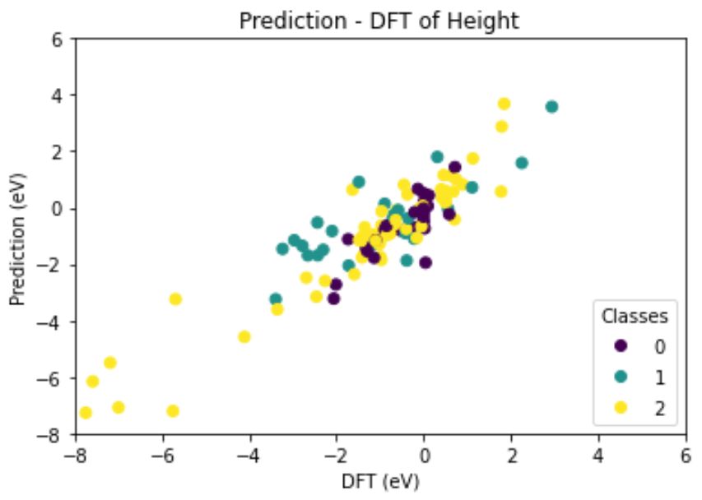
Results & discussion
Host elements
EEGNet
Using Au + period 6 elements SAAs to be testing data
Training data: 848
Testing data: 112
Prediction (eV)
Loss: 0.006174653
Accuracy: 0.09821
Correlation: 0.902148
H₂, O₂, N₂, CO₂
H, O, N, CO
Others
DFT (eV)
The correlation coefficient (0.902148) using Au-based SAAs as testing set is closed to that using arbitrary ones (0.900632).
The host elements is not the dominant factor.
This case also predicts the weak adsorption of the stable molecules.

Slide 15
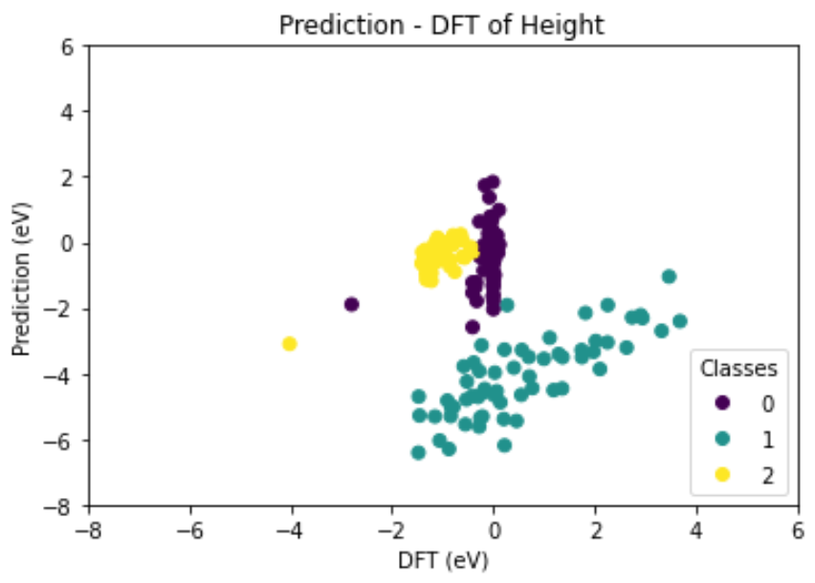
Results & discussion
Adsorbates
EEGNet
Using N, N₂, NH₃ adsorbed SAAs to be testing data
Training data: 780
Testing data: 180
Prediction (eV)
Loss: 0.044345028
Accuracy: 0.00556
Correlation: -0.212414
N₂
N
NH₃
DFT (eV)
The correlation coefficient (-0.212414) is very poor.
Only the NH₃ cases show the much accurate prediction due to H atoms.
The -5 eV offsets in the single atom cases.
Notes:
預期利用已知的data預測另一種催化反應之吸附能
HER, ORR, CO2RR➔NRR
N atoms的case被低估吸附能，估計EEGNet model沒有學習到具有2p軌域孤電子特徵之DOS

Slide 16
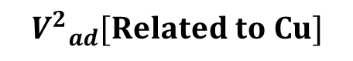
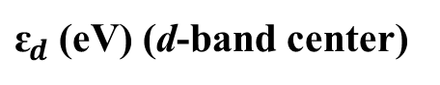
Results & discussion
Idealized d-band filling
In order to determine the importance of the d-band center
$${V^{2}}_{ad}[Related to Cu]$$
0.3 4.65 Ti 1.50 3.05 | 0.4 3.15 V 1.06 2.82 | 0.5 2.35 Cr 0.16 2.70 | 0.6 1.94 Mn 0.07 2.70 | 0.7 1.59 Fe -0.92 2.66 | 0.8 1.34 Co -1.17 2.62 | 0.9 1.16 Ni -1.29 2.60 | 1.0 1.0 Cu -2.67 2.67
0.3 10.9 Zr 1.95 3.35 | 0.4 7.73 Nb 1.41 3.07 | 0.5 6.62 Mo 0.35 2.99 | 0.6 4.71 Tc -0.60 2.84 | 0.7 3.87 Ru -1.41 2.79 | 0.8 3.32 Rh -1.73 2.81 | 0.9 2.78 Pd -1.83 2.87 | 1.0 2.26 Ag -4.30 3.01
0.3 11.9 Hf 2.47 3.30 | 0.4 9.05 Ta 2.00 3.07 | 0.5 7.27 W 0.77 2.95 | 0.6 6.04 Re -0.51 2.87 | 0.7 5.13 Os 2.83 | 0.8 4.45 Ir -2.11 2.84 | 0.9 3.90 Pt -2.25 2.90 | 1.0 3.35 Au -3.56 3.00
Bulk Wigner-Seitz radius, s(au)
${\text{ɛ}}_{d}$ (eV) (d-band center)
B. HAMMER and J. K. NØRSKOV. Theoretical Surface Science and Catalysis—Calculations and Concepts (2000)
Notes:
d-band center越高，吸附能越強

Slide 17
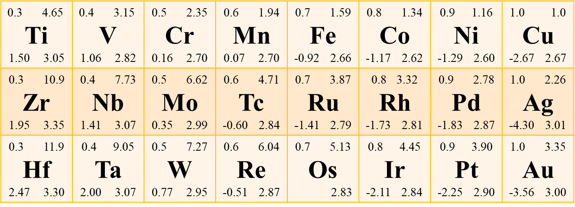
Results & discussion
d-band center
EEGNet
Using guest elements with higher d-band center in SAAs (Ti, V, Zr, Nb, Hf, Ta) to be testing data.
Using guest elements with lower d-band center in SAAs (Co, Ni, Rh, Pd, Ir, Pt) to be testing data.
Training data: 672
Testing data: 288

Slide 18
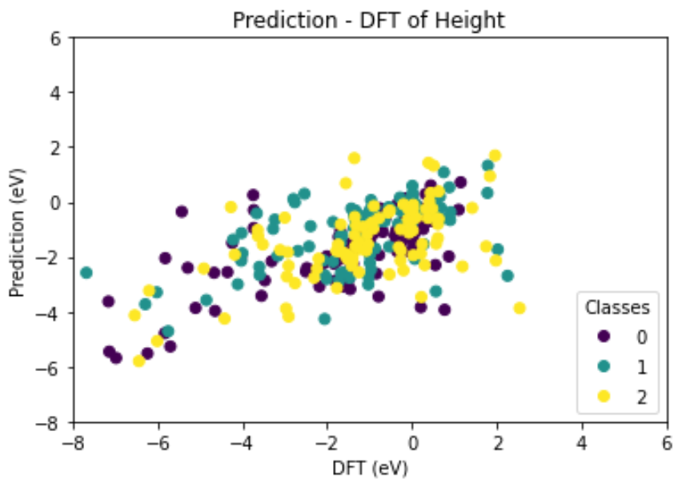
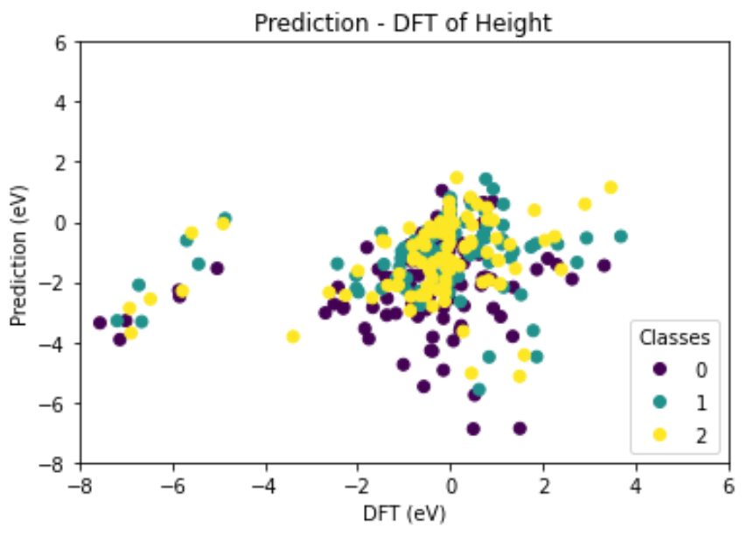
Results & discussion
d-band center ɛ_{𝒅}
EEGNet
Using higher ɛ_{𝒅} to be testing
Using lower ɛ_{𝒅} to be testing
Prediction (eV)
Prediction (eV)
Ag
Au
Cu
Ag
Au
Cu
DFT (eV)
DFT (eV)
Loss: 0.008672681
Accuracy: 0.07986
Correlation: 0.576008
Loss: 0.021839406
Accuracy: 0.04861
Correlation: 0.176401
Notes:
使用higher當testing，training set 是沒有higher的
使用高d-band center作為testing data有較高的準確率
與host elements間的波函數混和交互作用影響較小(高d-band center guest elements)
與host elements間的波函數混和交互作用影響較大(低d-band center guest elements)➔d-band dominant
d-band center may be needed to be the descriptor in this model.

Slide 19
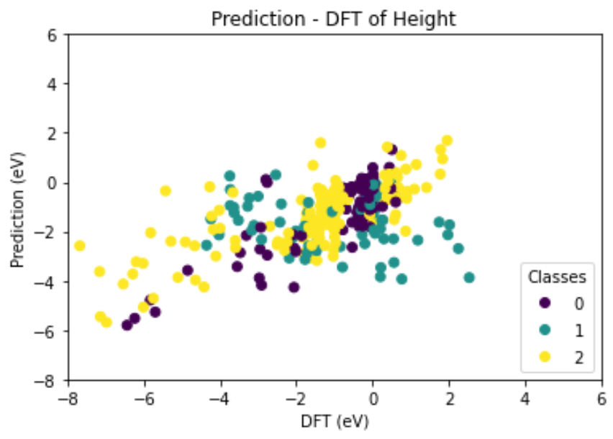
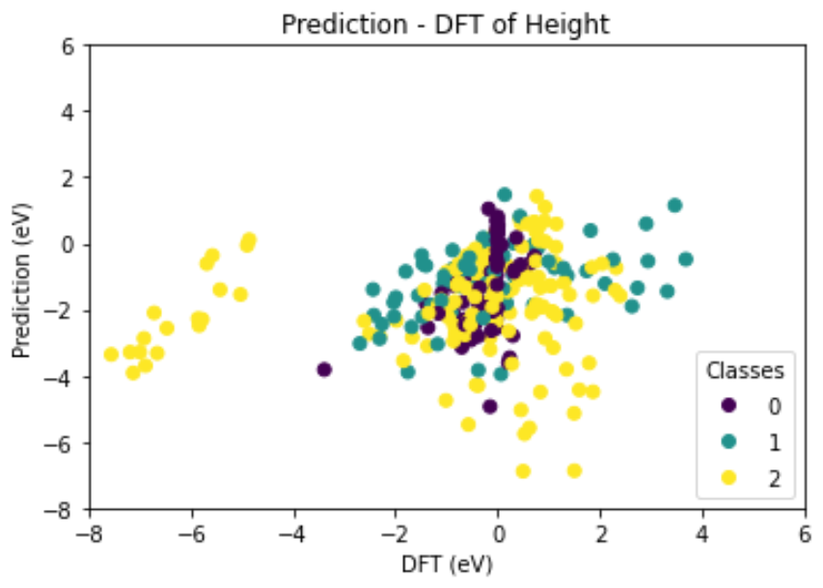
Results & discussion
d-band center ɛ_{𝒅}
EEGNet
Using higher ɛ_{𝒅} to be testing
Using lower ɛ_{𝒅} to be testing
H₂, O₂, N₂, CO₂
H, O, N, CO
Others
H₂, O₂, N₂, CO₂
H, O, N, CO
Others
Prediction (eV)
Prediction (eV)
DFT (eV)
DFT (eV)
Predict the dissociative adsorption on the guest elements SAAs with high d-band center which is similar to the pure metal surface.
The weak chemisorption occurs on the guest elements with lower ɛ_{𝒅}.

Slide 20
Conclusion
The EEGNet model is suitable for training the case with less data compared to the DeepConvNet model.
Using DOS to predict the adsorption energies of SAAs.
Maybe predict another catalysis reaction.
Determining the important factor to influence the predictions.
d-band center > adsorbates > host elements

Slide 21
Job arrangement
高睿成: 主導final project/data generation/ppt製作/ppt講解/書面報告製作
陳冠儒: main code/ppt製作/ppt講解/書面報告製作
蔡沂華: data post-process/ppt製作/ppt講解/書面報告製作

